Slide 1
Using TDD compared to manual testing
Vladyslav Nekriach, Victoria Kovalenko

Slide 2


Problem:
Can developers reduce the amount of bugs at the stage of development (before the QA)? Is there a better alternative to manual testing of code? Real world case study:

Slide 3
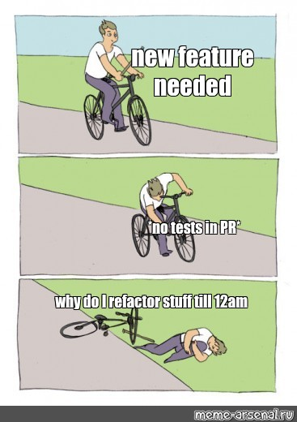
Experiment:
Small experiment - 3 month of manual testing only, 3 month of TDD in an enterprise project
Mostly unit tests, sometimes integration testing
Most of the features we worked on were small incremental changes / bug fixes
All of the features were passed to QA afterwards and either were accepted or reverted due to bugs in code

Slide 4

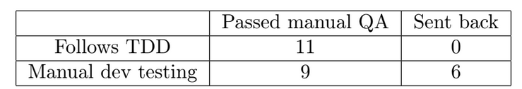
Results:
TDD works for authors
You should try it too!
From experience: - Easier to write code - Reduces probability of human error

Slide 5
THANK YOU! <3

